Slide 1
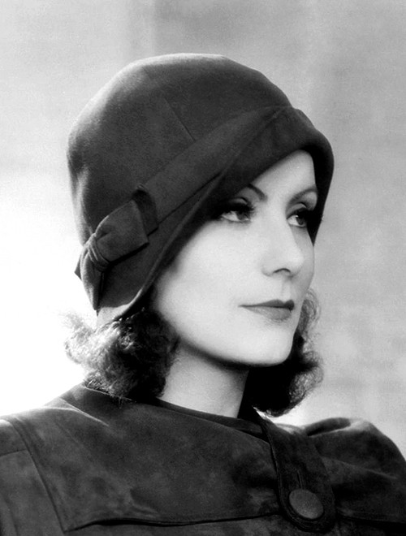
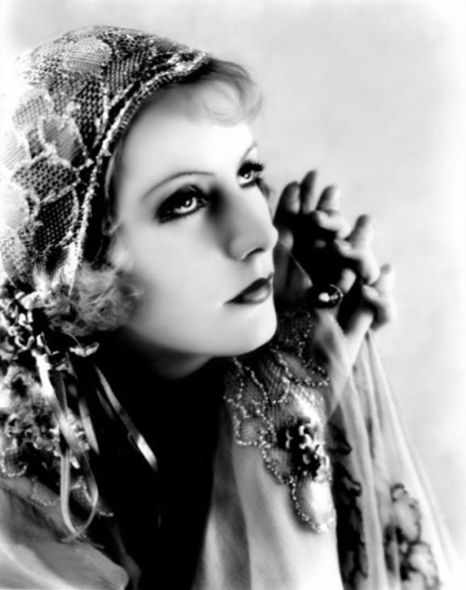
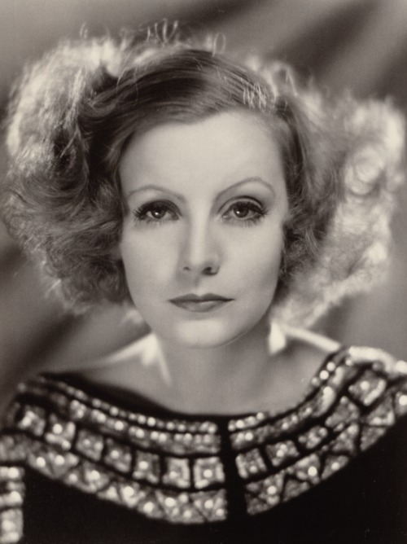
Early 1900’s (1900-1940’s)

Slide 2
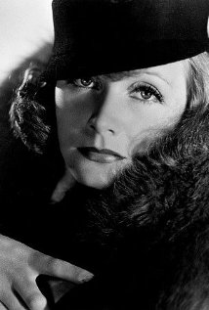
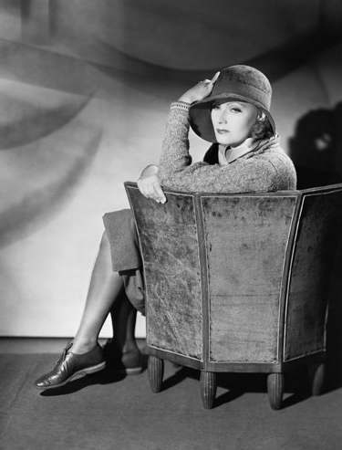
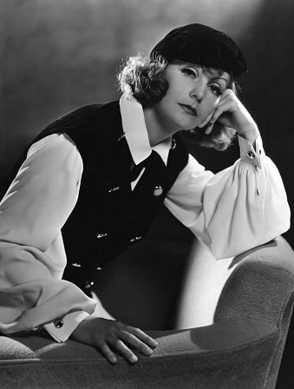
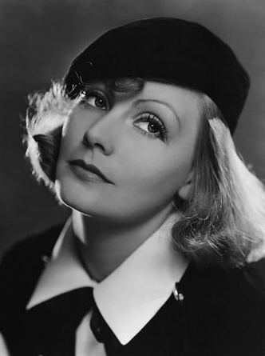
Greta Gustafsson Greta Garbo
Greta Gustafsson was born in Stockholm, Sweden on September 18th, 1905
She was discovered when she was a “young drama student” by Mauritz Stiller (director) who changed her name to Greta Garbo
Her career had started and in 1925, she began starring in silent films
In 1930, Garbo switched to starring in movies with sound
Greta Garbo “refused to speak to reporters and banned visitors from her film sets.”
It was in 1941 (at the age of 36) that Garbo retired which was the peak of her fame. It is said that Greta retired because of her need for privacy, which was obviously not given to her at the time of her popularity.

Slide 3
The Joyless Street 1925
“Postwar Vienna is filled with greedy men and, opposed to them, families made poor by the war. Franz Rumfort (Jaro Furth) is the head of such an impoverished family. Greta (Greta Garbo) is the eldest of his daughters and is trying to hold the family together. Maria Lechner (Asta Nielsen) is part of this society. She has a lover, and kills to keep him from marrying someone else.
Then she turns herself in to save her lover. A butcher (Werner Krauss), who symbolizes the type of lecher that a postwar society can create, is killed by those he has abused. Greta is about to become a woman of ill-repute when she is saved by her father, with the help of a Red Cross lieutenant (Einar Hanson).”

Slide 4
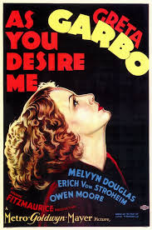
AS YOU DESIRE ME (1932)
“Zara (Greta Garbo), is a cafe entertainer in Budapest. She has amnesia. Tony Boffie (Owen Moore) sees her and identifies her as Maria. Maria is the wife of Count Bruno Varelli (Melvyn Douglas). Boffie, a portrait painter, had done a painting of Maria at the time of her marriage. She was believed to have been killed when the Austrians invaded Italy during the war. Zara, wanting to escape from Carl Salter (Erich von Stroheim). Salter, a novelist who has a hypnotic influence over her. He decides to go back with Boffie. Varelli accepts her as his wife and she falls in love with him. Salter, wanting her back, brings another woman to Varelli saying Zara is an imposter. But does not succeed in his venture. Zara continues to be Varelli's wife, although she is still not certain of her true identity.”

Slide 5
Garbo Stereotyped?
It was often in Garbo’s films that we could see women stereotyped against.
Greta’s character almost always needed to be saved by a man
Hardly ever did she play the strong and independent woman that women are portrayed to be in todays society and movies as well
It was as if her character was never in charge of her own destiny…the man in her life was in charge of that for her…

Slide 6
http://www.youtube.com/watch?v=dpY7w3SxNyE
Greta Garbo in Action!

Slide 7
Mid-1900s
Women in Film

Slide 8
Top Actress: Marilyn Monroe

Slide 9
Marilyn Monroe
Norma Jean Baker endured a fatherless childhood of sexual abuse and poverty .
Put in a string of orphanages and foster homes after mother Gladys Baker, who suffered mental illness.
She was born on 1st June 1926 in the Los Angeles County Hospital, the third child of Gladys Baker.
At 16, she escaped her old life by marrying a 21-year-old aircraft plant worker, Jim Dougherty, who she divorced four years later.
She married playwright Arthur Miller the same year, divorcing him four years on.
In the meantime, she fell prey to alcohol and pills, and suffered two miscarriages
She went into seclusion and on 5 August 1962, she was found dead at her home of an overdose of sleeping pills, aged 36.
The verdict was suicide but has always been disputed, with countless conspiracy theories triggered by alleged affairs with brothers John F and Robert Kennedy.

Slide 10
Portrayed in Films
Typical “Dumb Blond”
She was an American actress, singer, model and showgirl who stared in a number of commercially successful motion pictures.
Always got the dumb role to show men’s superiority in society.

Slide 11
Portrayed in Films
A Sex symbol in the 1950s.
She was the sexy diva embodied everything that man desired and woman dreamed of: having fun, famous, rich, admired, and successful.
She has blond hairs, beauty mark, red lips and with big laugh which showed a “stereotypical” Hollywood beauty should be.

Slide 12
A Quick Video of her career in Film industry.
http://www.youtube.com/watch?v=e5_GTzZFwwI

Slide 13
Present Day

Slide 14
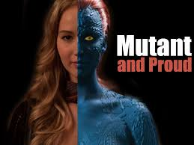
Movies
1. Winter’s Bone
2. Hunger Games Series
3. X-men: First Class

Slide 15
Winter’s Bone- 2010
Her family home in danger of being repossessed after her meth-cooking dad skips bail and disappears, Ozark teen Ree Dolly (Jennifer Lawrence) breaksthe local code of conduct by confronting her kin about their conspiracy of silence. Should she fail to track her father down, Ree Dolly, her younger siblings, and their disabled mother will soon be rendered homeless
In the movie, she plays a teenage girl that is willing to fight for her family, despite the fact that she is a 17 year old girl. The community they live in is male dominated and she is overlooked due to her age and sex.
The role is a strong female role that pictures a girl our age fighting for her family.
She was nominated for an Oscar in 2011 as best female role for this movie

Slide 16
Hunger Games-2012 Catching Fire-2013
The Hunger Games series is about a girl in poverty who is sent into an arena with 23 other teenagers, when only one will walk out alive. She ends up accidently starting a revolution. She keeps fueling the revolution with unintentional acts of defiance.
In the series, Jennifer Lawrence fights against the oppressive government not intentionally, but in order to save her own family and friends. It starts with her sacrificing herself for her sister and ends the series willing to die rather than kill Peeta.

Slide 17
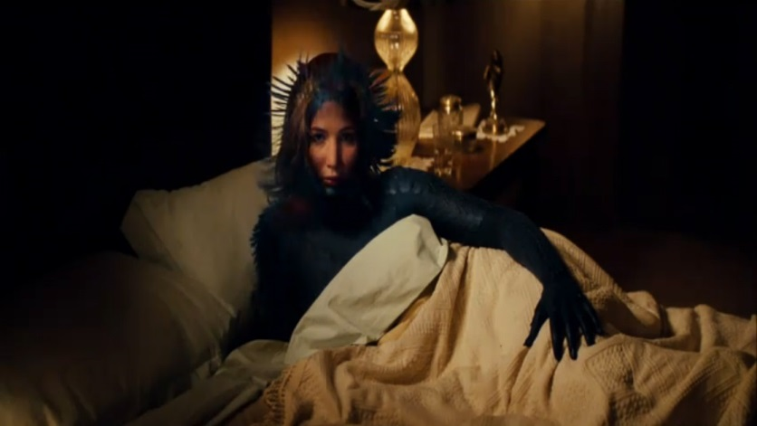
X-men: First Class-2011
Jennifer Lawrence plays the character Mystique in the movie’s X-Men: First Class and X-Men: Days of Future Past. She grows up hiding her ability and trying to fit in with everyone else. She is always wearing someone else’s face and is constantly jealous of how other people look. Throughout the movie, she discovers that who she is on the outside does not matter and to stop hiding or care what other people think of her.

